Slide 2
Index
1.Project Overview
2.Architechture
3.Data Overview
4.Methodology
5.Monitoring
6.Visualization

Slide 3
Understanding Problem Statement

Slide 4
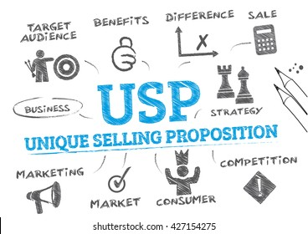
Unique Selling Points
USP Pillar | Technical Backbone | Business Outcome
⚙️ Real-Time Pipeline | Snowpipe, Streams, IICS | Live operational visibility
🔐 Secure Data Access | Masking Policy, RLS, Secure Share | Regulatory compliance
📈 Insightful Dashboards | Tableau + Snowflake Live Connection | Actionable analytics
🌍 Scalable Cloud | AWS + Snowflake Elastic Compute | Global scalability
💸 Cost Savings | Data-driven Optimization | Reduced delays & fuel costs

Slide 5
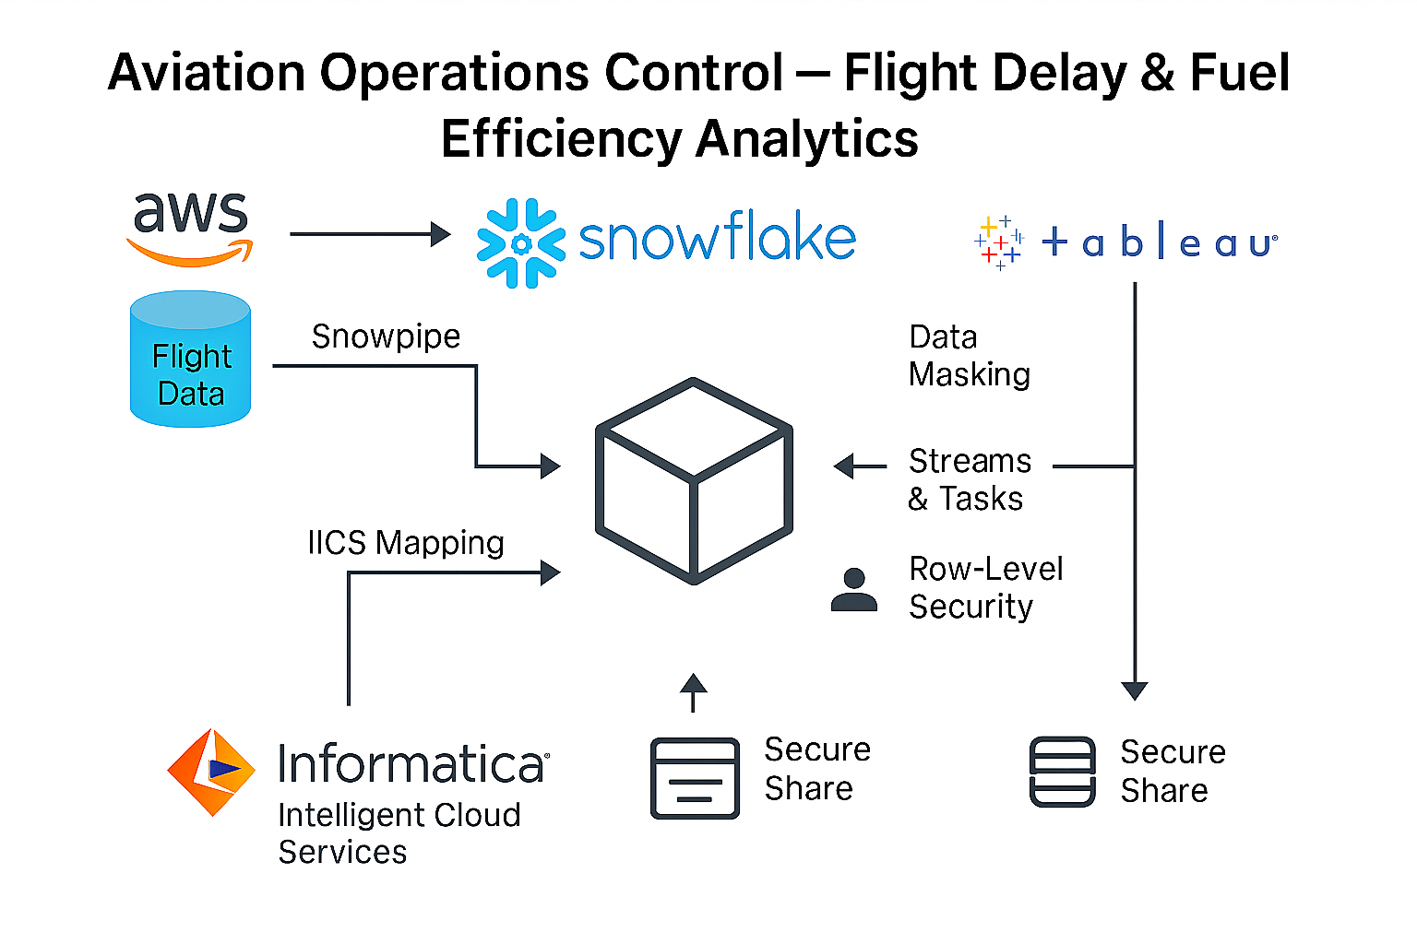
Workflow

Slide 6

Data Overview
The Data have majorly 6 datasets:
Aircraft Master : 320 records
Airport Master : 160 records
Flight Operations: 45000 records
Flight Schedule: 30000 records
Fuel Consumption :4000 records
Region Hierarchy :180 records
Having different Insights and different categorical data.

Slide 7
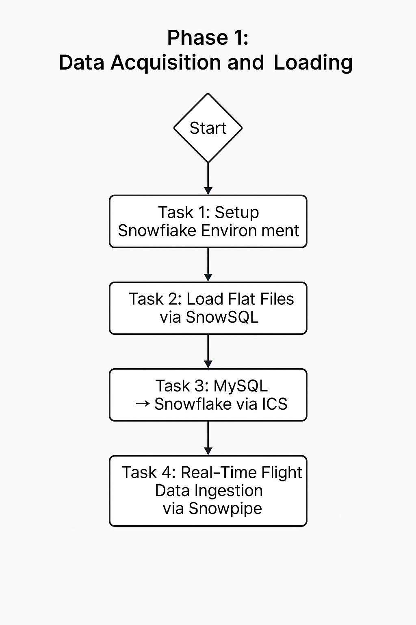

Data Acquisition and Loading

Slide 8
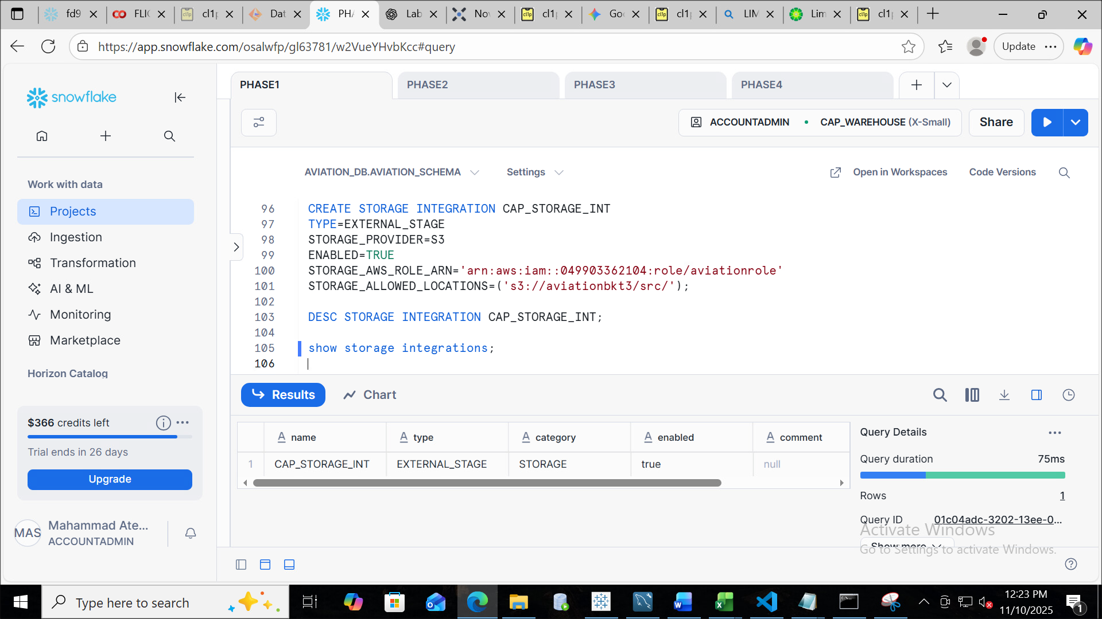
Creating Storage Integration
In this step an Aviation stage is being created and integrated with the s3 bucket.
Reason: So that your Aws credentials are not exposed

Slide 9
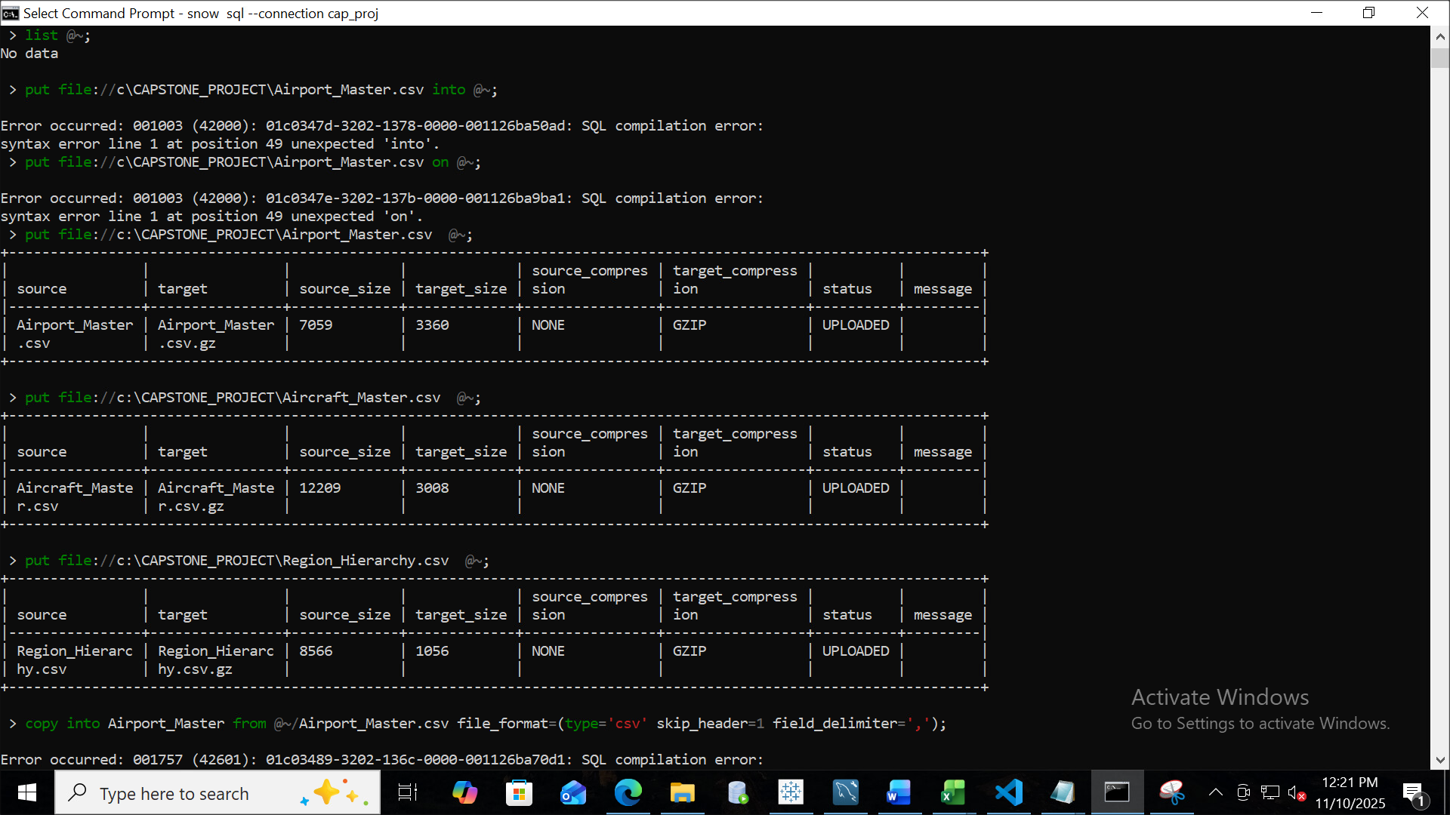
Loading the data with internal stages

Slide 10
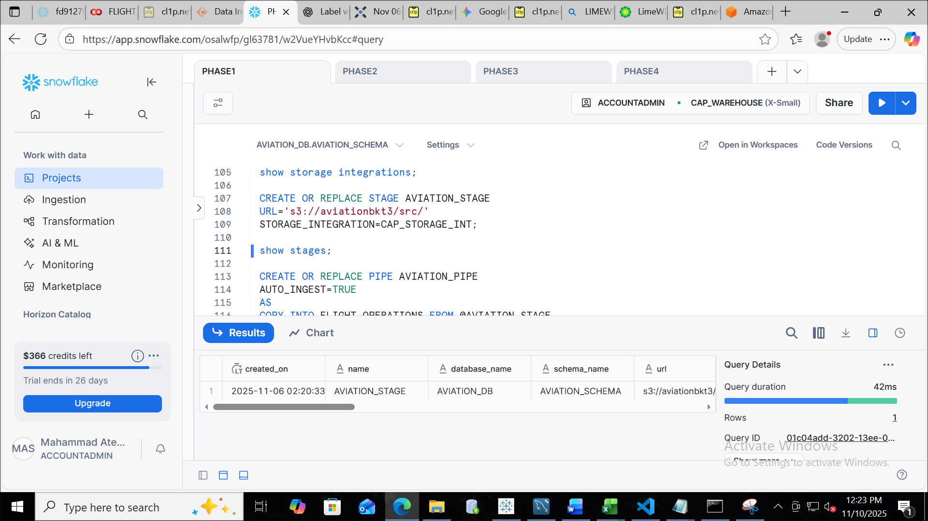
Creating external stage for aws S3

Slide 11
Creating Snowpipe for Automation

Slide 12

Data Modelling and Schema

Slide 13
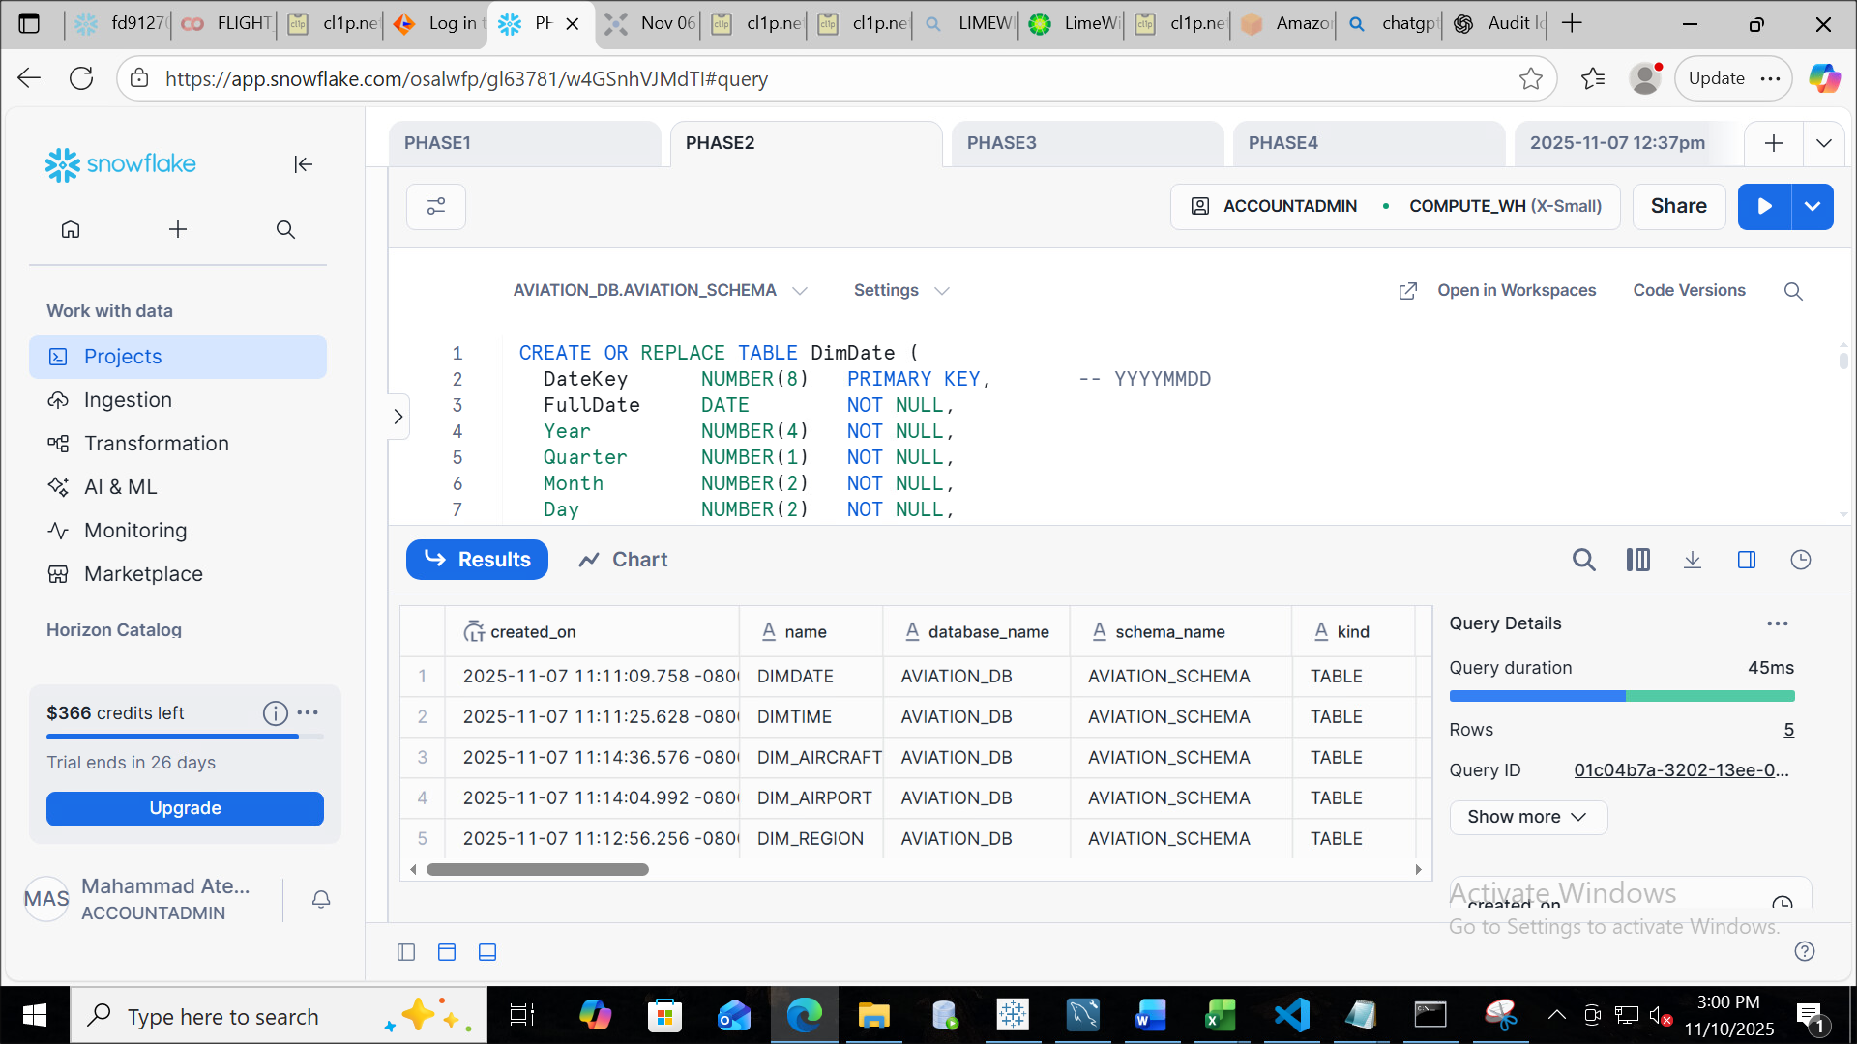
Building Dimension Tables
In this step we are creating Dimension tables from the actual tables
According to the fields that are required
DimDate,DimTime,DimAircraft,
DimAirport,DimRegion

Slide 14
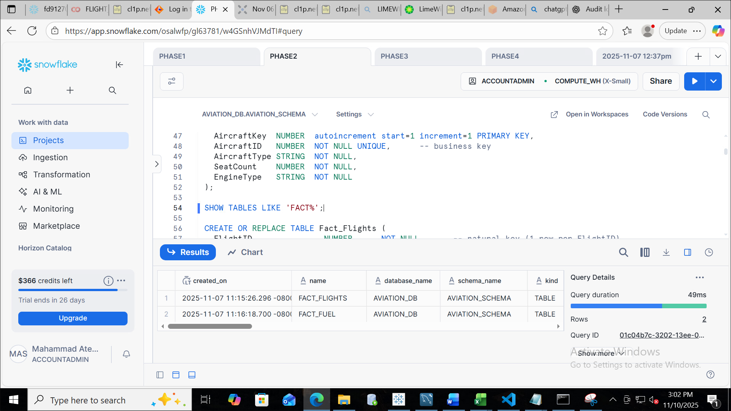
Building Fact Tables
In this step we are building the
fact tables which stores
quantitatve data for analysis
like foreign key or metrics.
We have created two fact tables:
1:FactFlights
2:FactFuel

Slide 15

Surrogate Keys
Surrogate Key is a generated or an artificial key
that is used to uniquely identify a record in table
typically in dimension tables of a data
Why are they used?
Uniqueness
Performance
Stability
Simplifies ETL

Slide 16
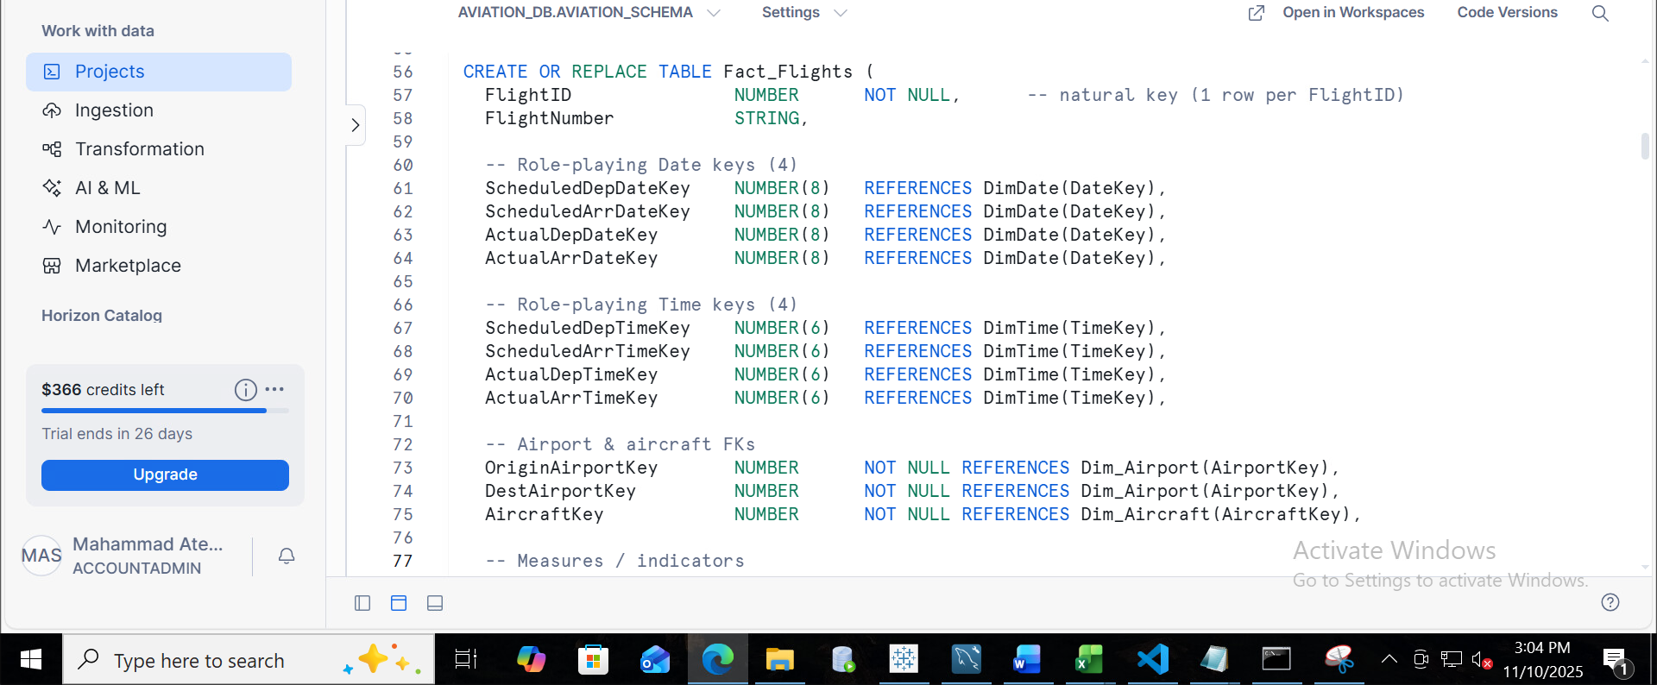
Application of Surrogate Keys

Slide 17
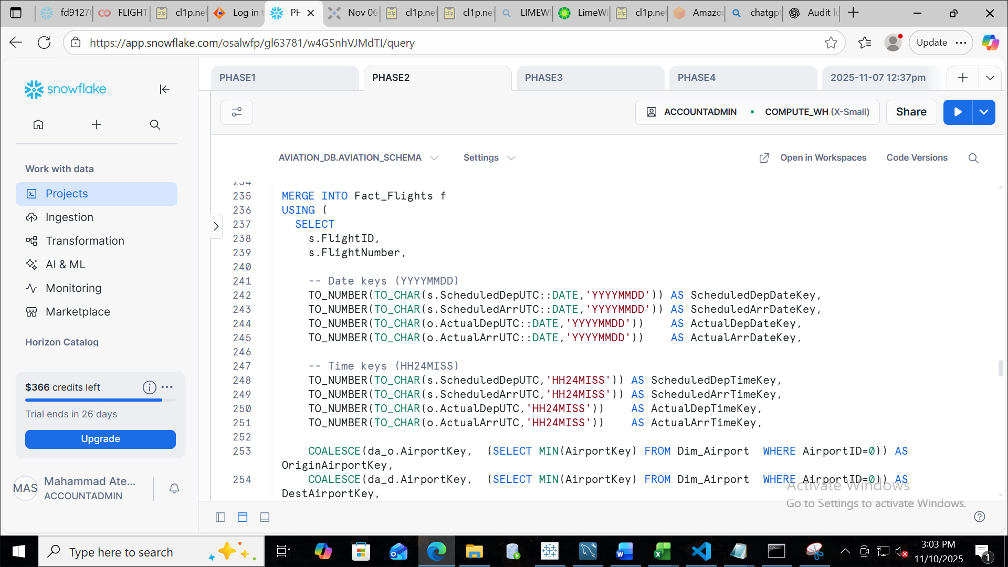
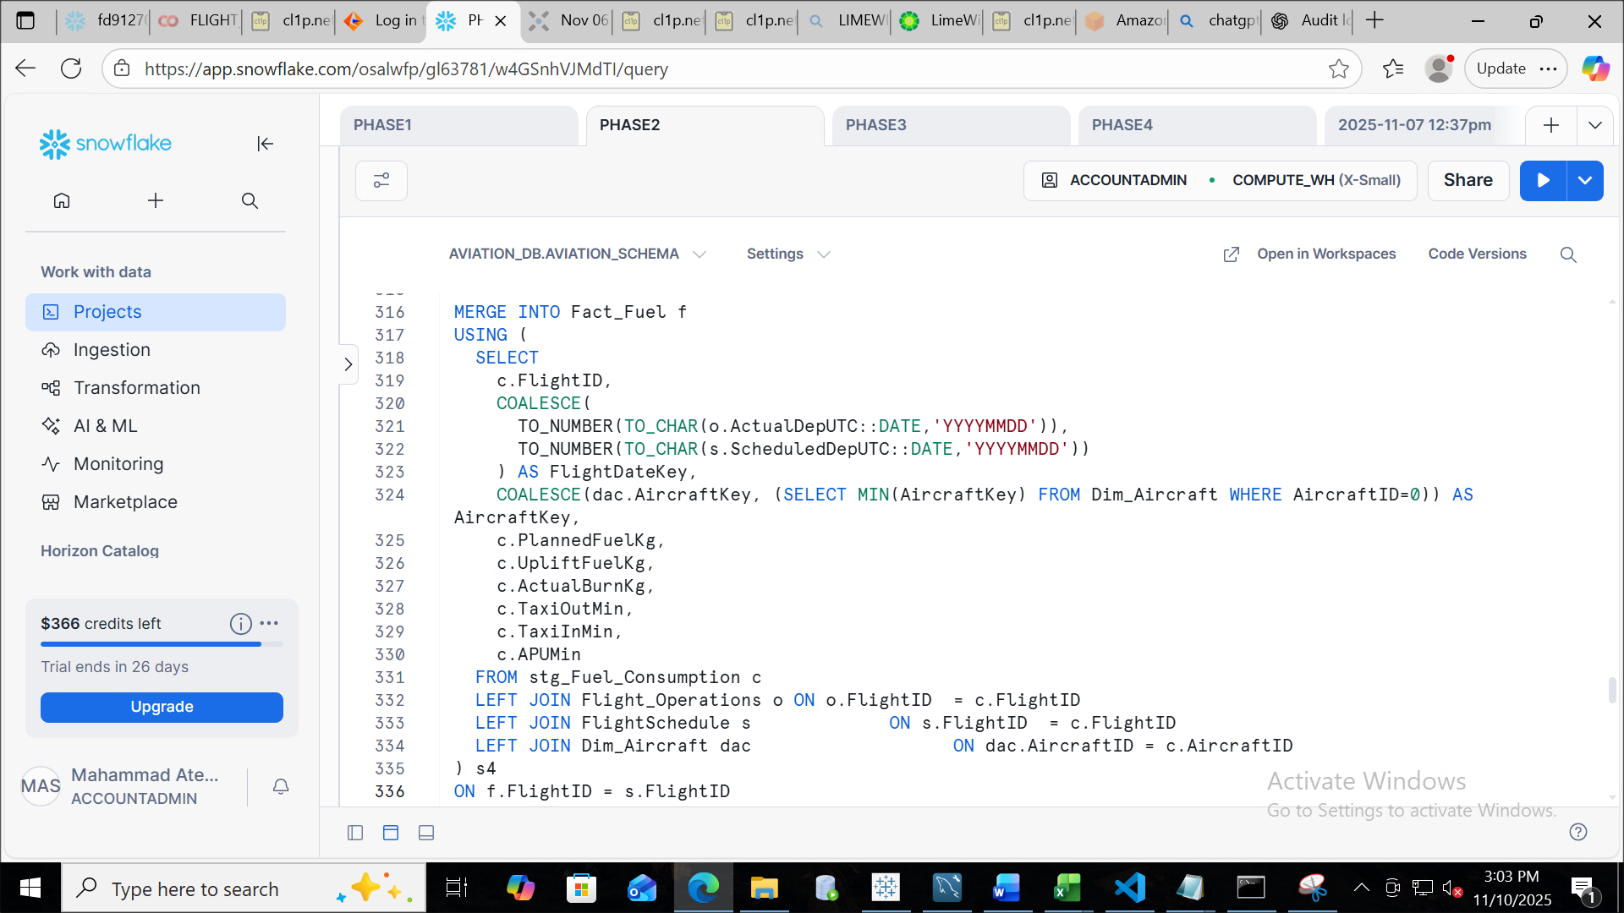
Merge Operations
In Snowflake, the Merge statement is used to perform conditional insert, update, or delete operations on a target table based on the results of a join with a source table or subquery.
It's especially useful for upsert operations.
Merge on FactFlights
Merge on FactFuel

Slide 18

Incremental Automation Using Streams, Tasks, and MVs

Slide 19
Stream Setup

Slide 20







Task Creation
a Task is a powerful feature that is used to automate SQL operations
Example: INSERTION,MERGE,CALL etc.
⚙️ Automate Maintenance
⏱ Automate Repetitive Workflows
🔄 Enable Incremental Data Processing
🔗 Create Task Chains (DAGs)
📉 Improve Data Freshness

Slide 21
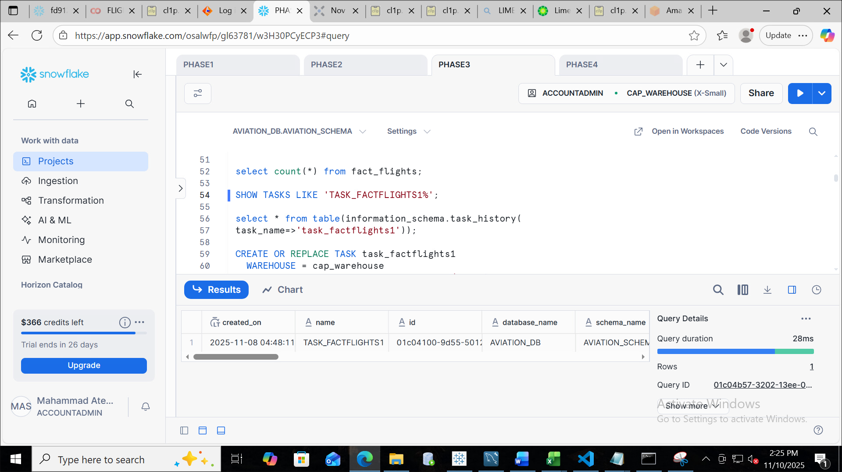

Creating the task
Task created successfully

Slide 22

Materialized Views
A Materialized View (MV) is a precomputed, stored result of a query that is automatically refreshed as the underlying data changes.
⚡ Faster Query Performance
🔁 Automatic Refresh
💰 Cost Efficiency
📊 Ideal for Dashboards
📥 Supports Incremental Updates

Slide 23
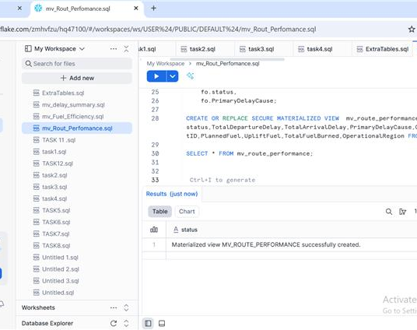
Three Materialized views have been created like this one to calculate the
Performance fields
1:mv_route_performance: delay and fuel stats by route pair
2:mv_delay_summary: average delay and OTP% by airport
3: mv_fuel_efficiency: actual vs. planned fuel per fleet

Slide 24

Security , Governance and Sharing

Slide 25

Data Masking
Data Masking in Snowflake is a security feature used to protect sensitive data by hiding or changing the data .
It ensures that only users with right privilege or access can view the actual data.
Key Points
🛡️ Protect Sensitive Information
✅ Ensure Regulatory Compliance
👥 Role-Based Access
🔄 Dynamic Masking

Slide 26
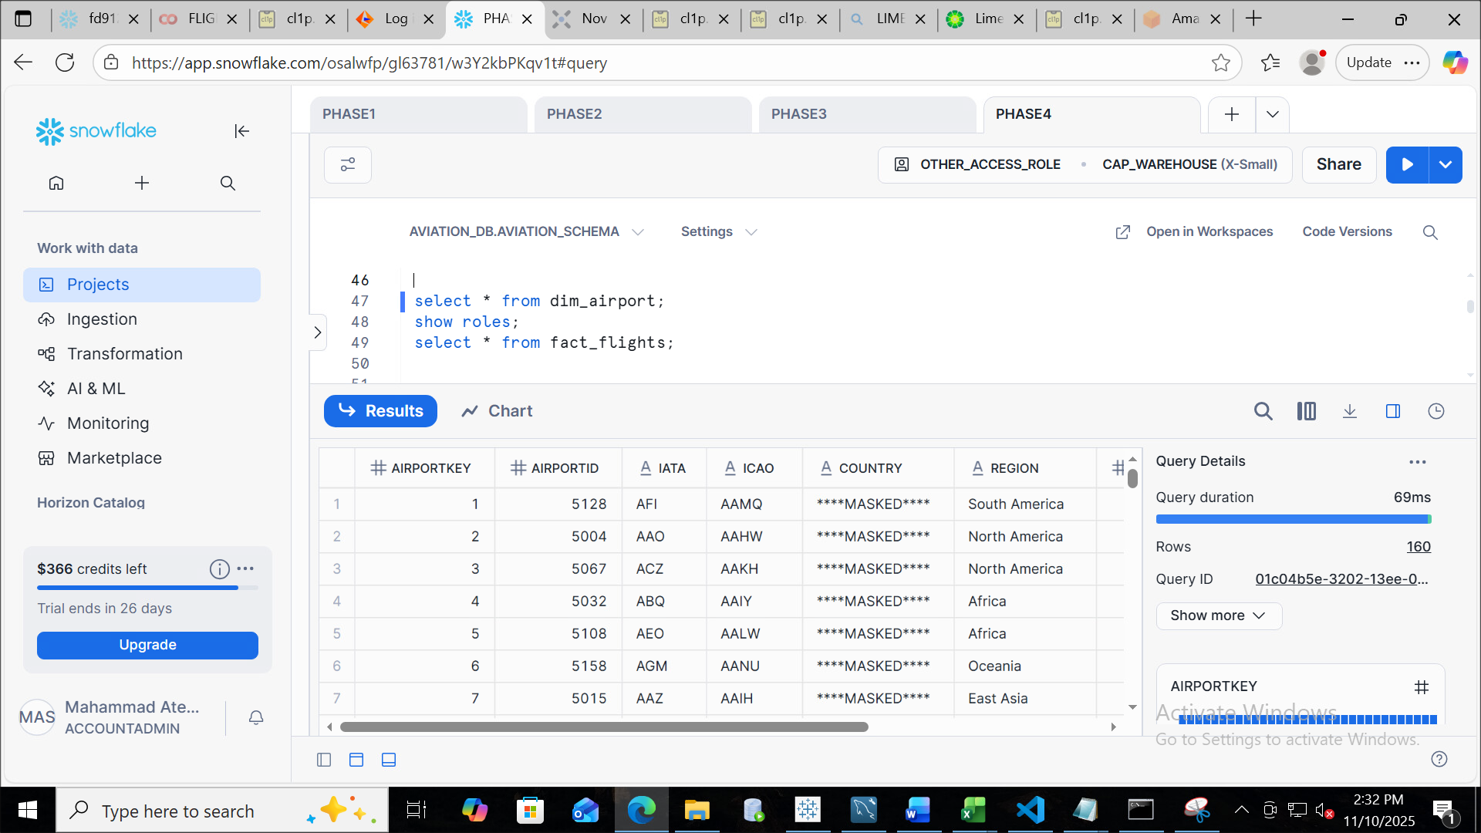
Application of Masking policy on Country

Slide 27
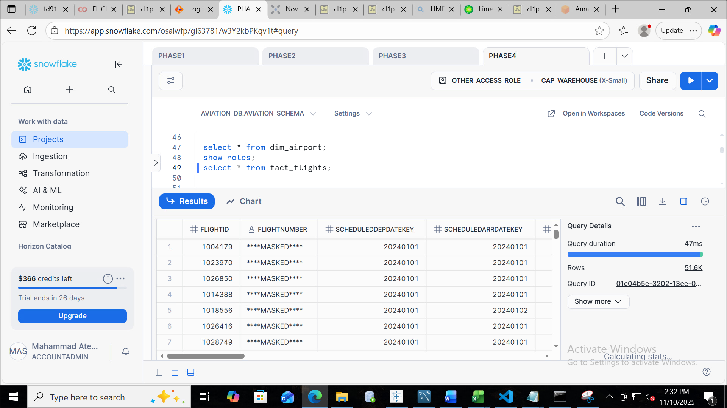
Application of Masking Policy on Flight Number

Slide 28

Row Access Policy
.
Row Access Policy in Snowflake is a data security feature that controls which rows of data a user can see based on their role, attributes, or session context.
It’s a powerful way to implement by categories control.
Why to Use Row Access Policy?
🔐 Enforce Data Privacy
✅ Regulatory Compliance
🧩 Dynamic Filtering
📊 Secure Data Sharing

Slide 29
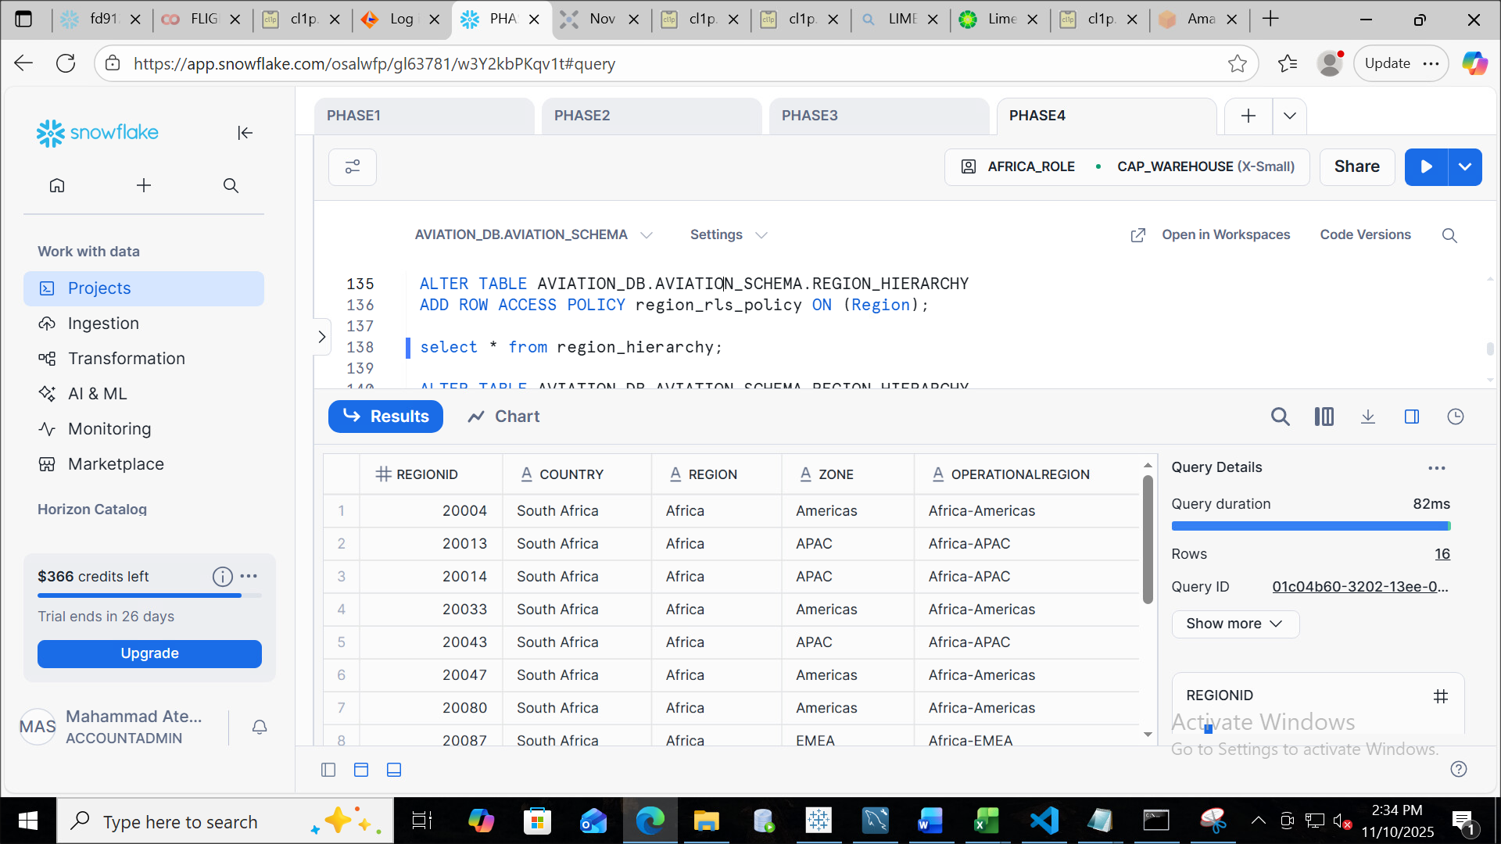
Row Access Policy based on Region

Slide 30

Secure Data Sharing
Secure Data Sharing is a feature that allows us to share data with other Snowflake accounts or external consumers without copying or moving the data.
This ensures security, governance, and cost efficiency.
Why to use Secure Data Sharing?
🔐 No Data Movement
⚡ Real-Time Access
✅ Governance & Compliance
🌍 External & Internal Sharing

Slide 31
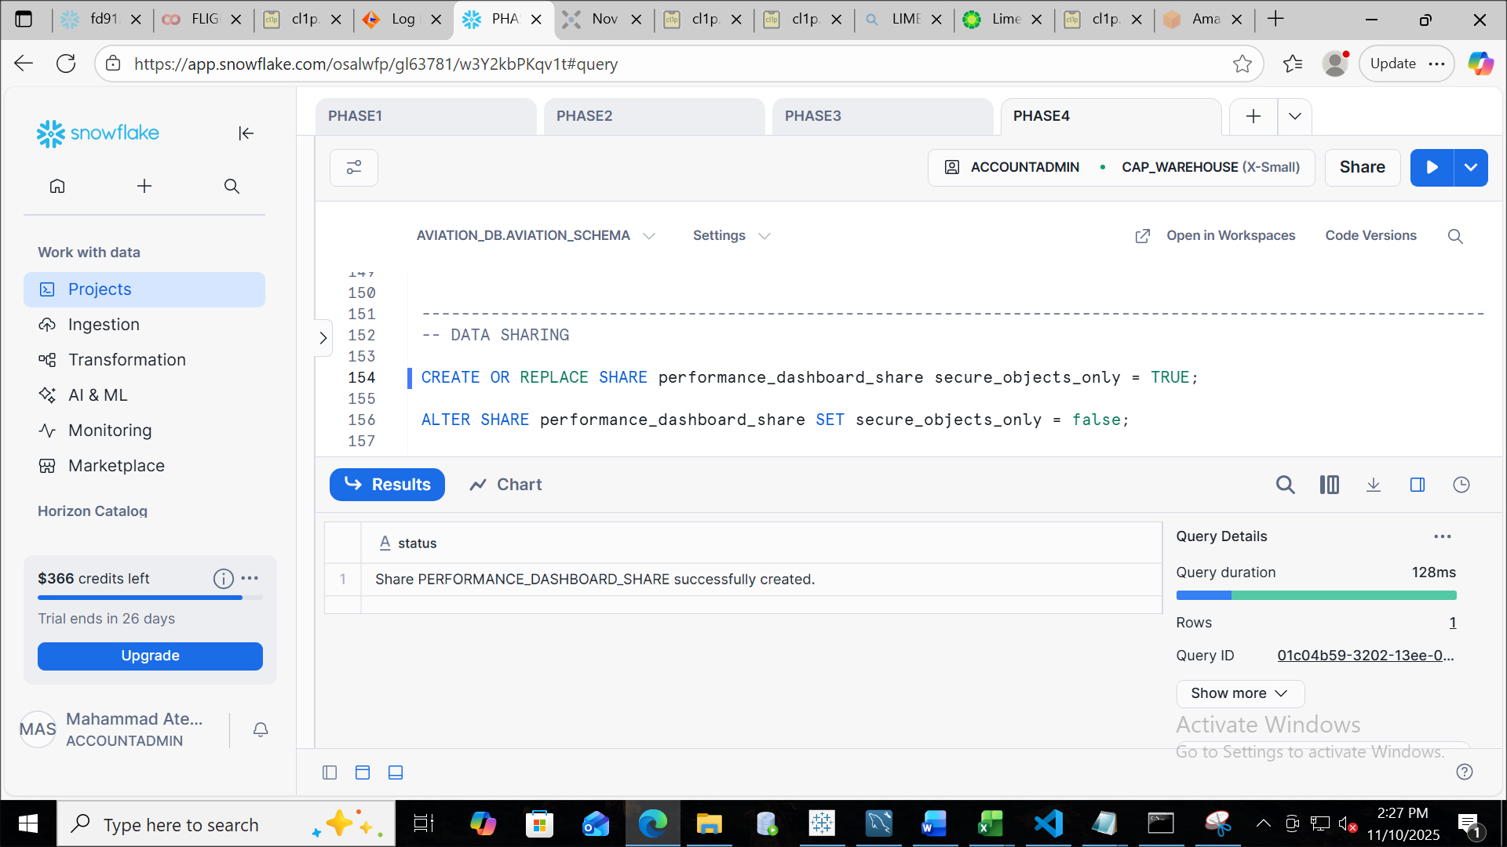
Share Creation

Slide 32
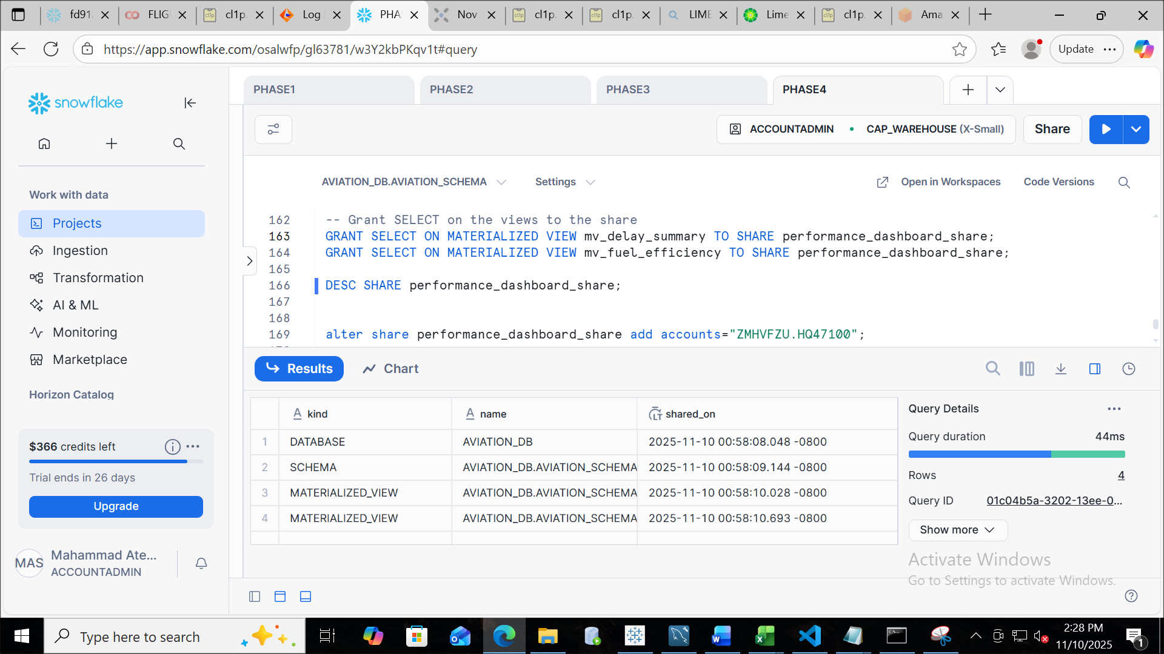
Share Description

Slide 33
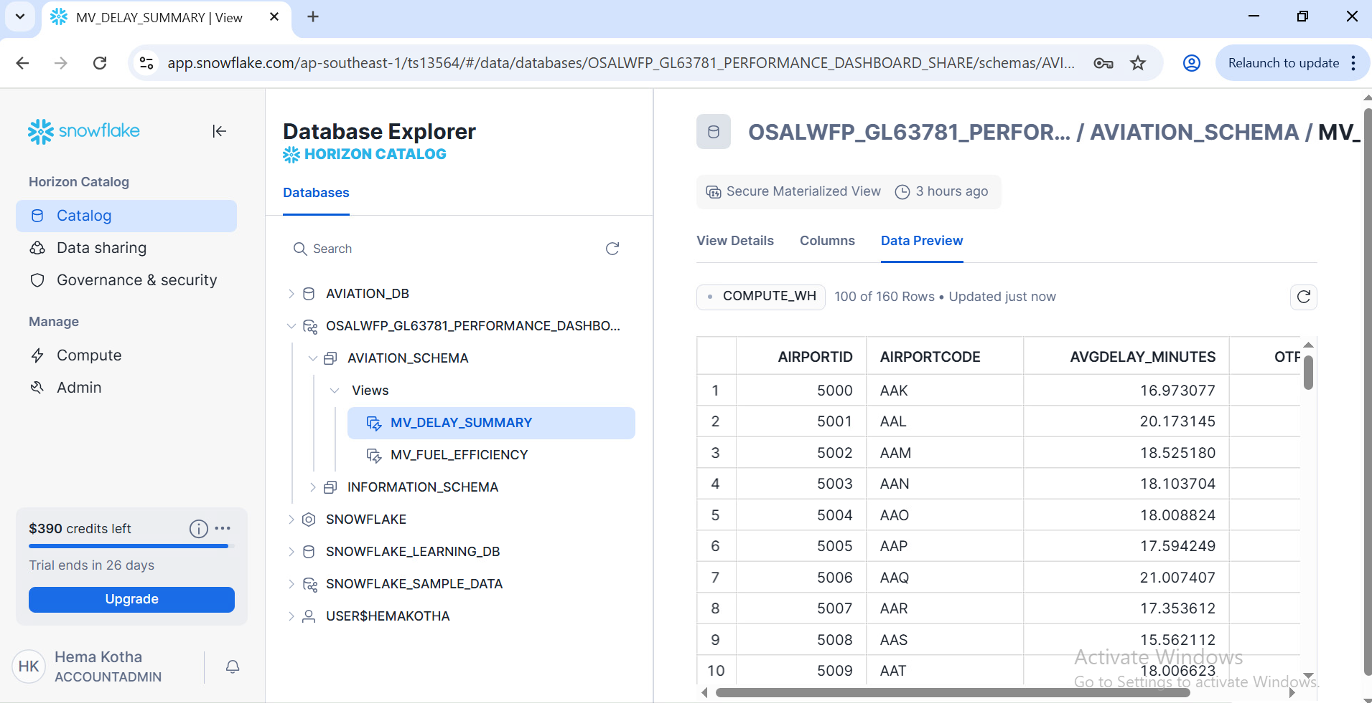
Share Customer Inbound

Slide 34
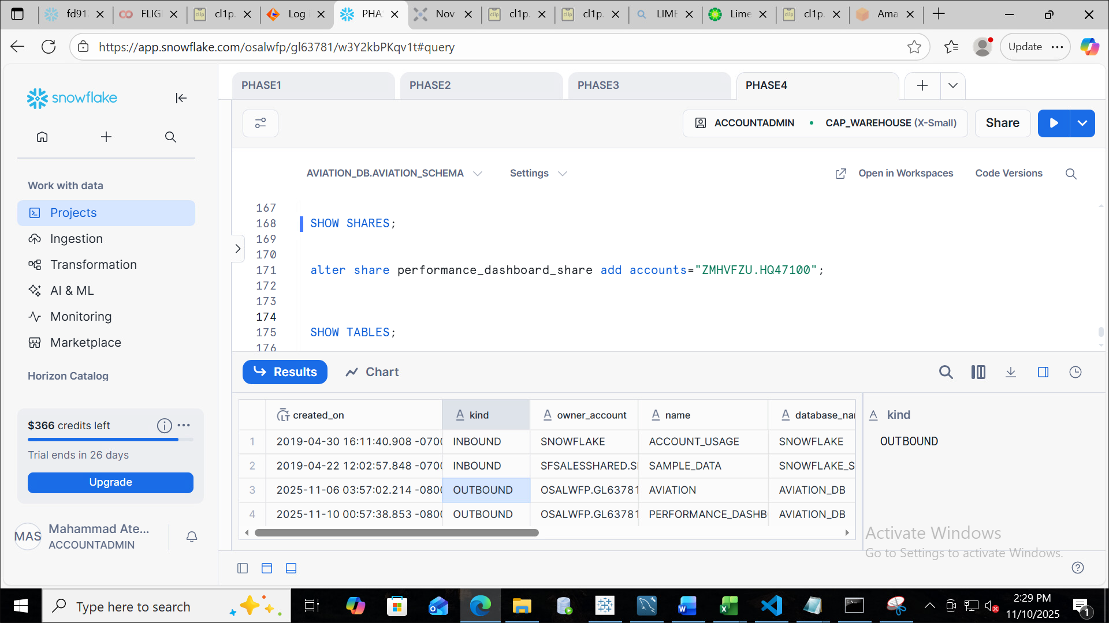
Share Customer Outbound

